Slide 1

DDM3040 ~ Design For Live Streaming
CA2: Analysis of your favorite live streaming video
IT114105(LWL)
Name: Chan Tsz Chung
Student Number: 230346622

Slide 2
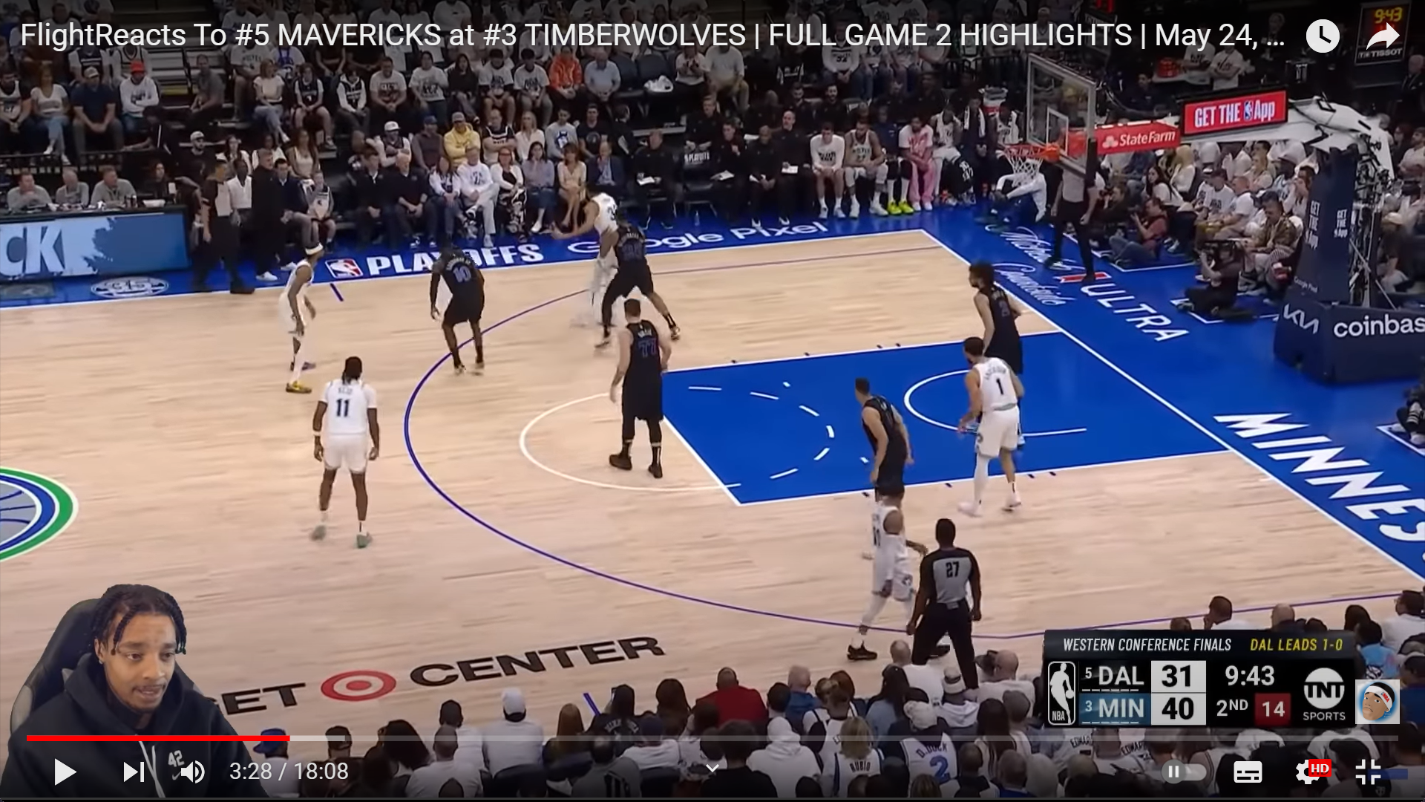
Live Show and Event - NBA
https://www.youtube.com/watch?v=29jp6Jy94VA

Slide 3
Direction, written inspiration:
This is a reaction video of an NBA game
The streamer provide a commentary of the NBA game and analysis the game play in the NBA game.
A real first-time reaction of the NBA game
Provide joyful environment to the viewer and entertain viewer

Slide 4
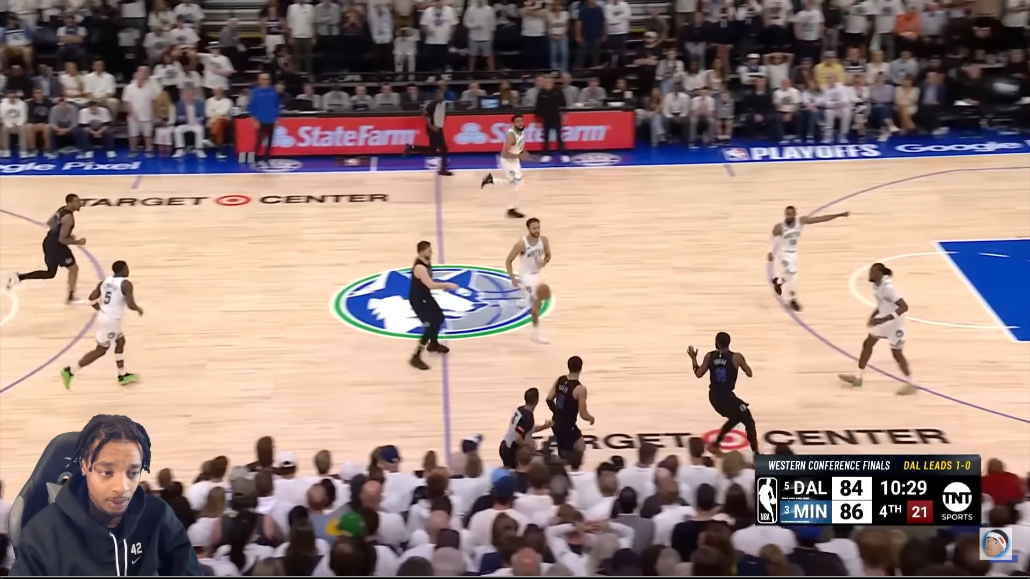
Visual: Aesthetic
A full screen of
an NBA game
Using green screen
as background to
Make himself fit into the video
Just NBA game video and front camera,
whole screen is very clean

Slide 5
Visual: Style
Style: Conciseness
Don’t have border line
Around him

Slide 6
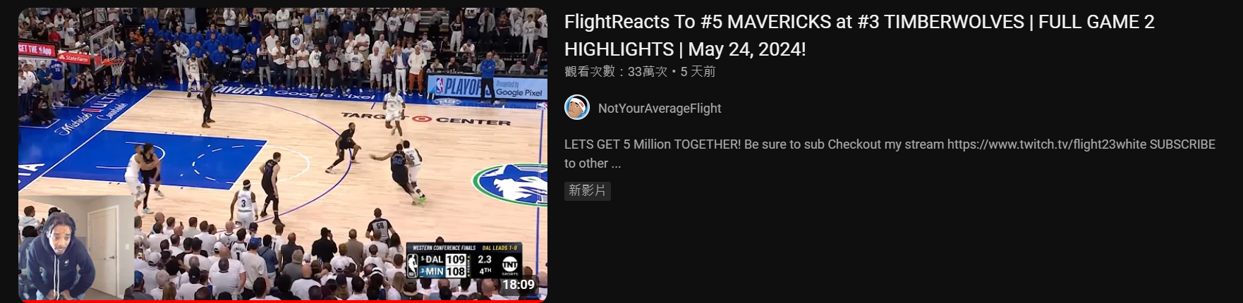
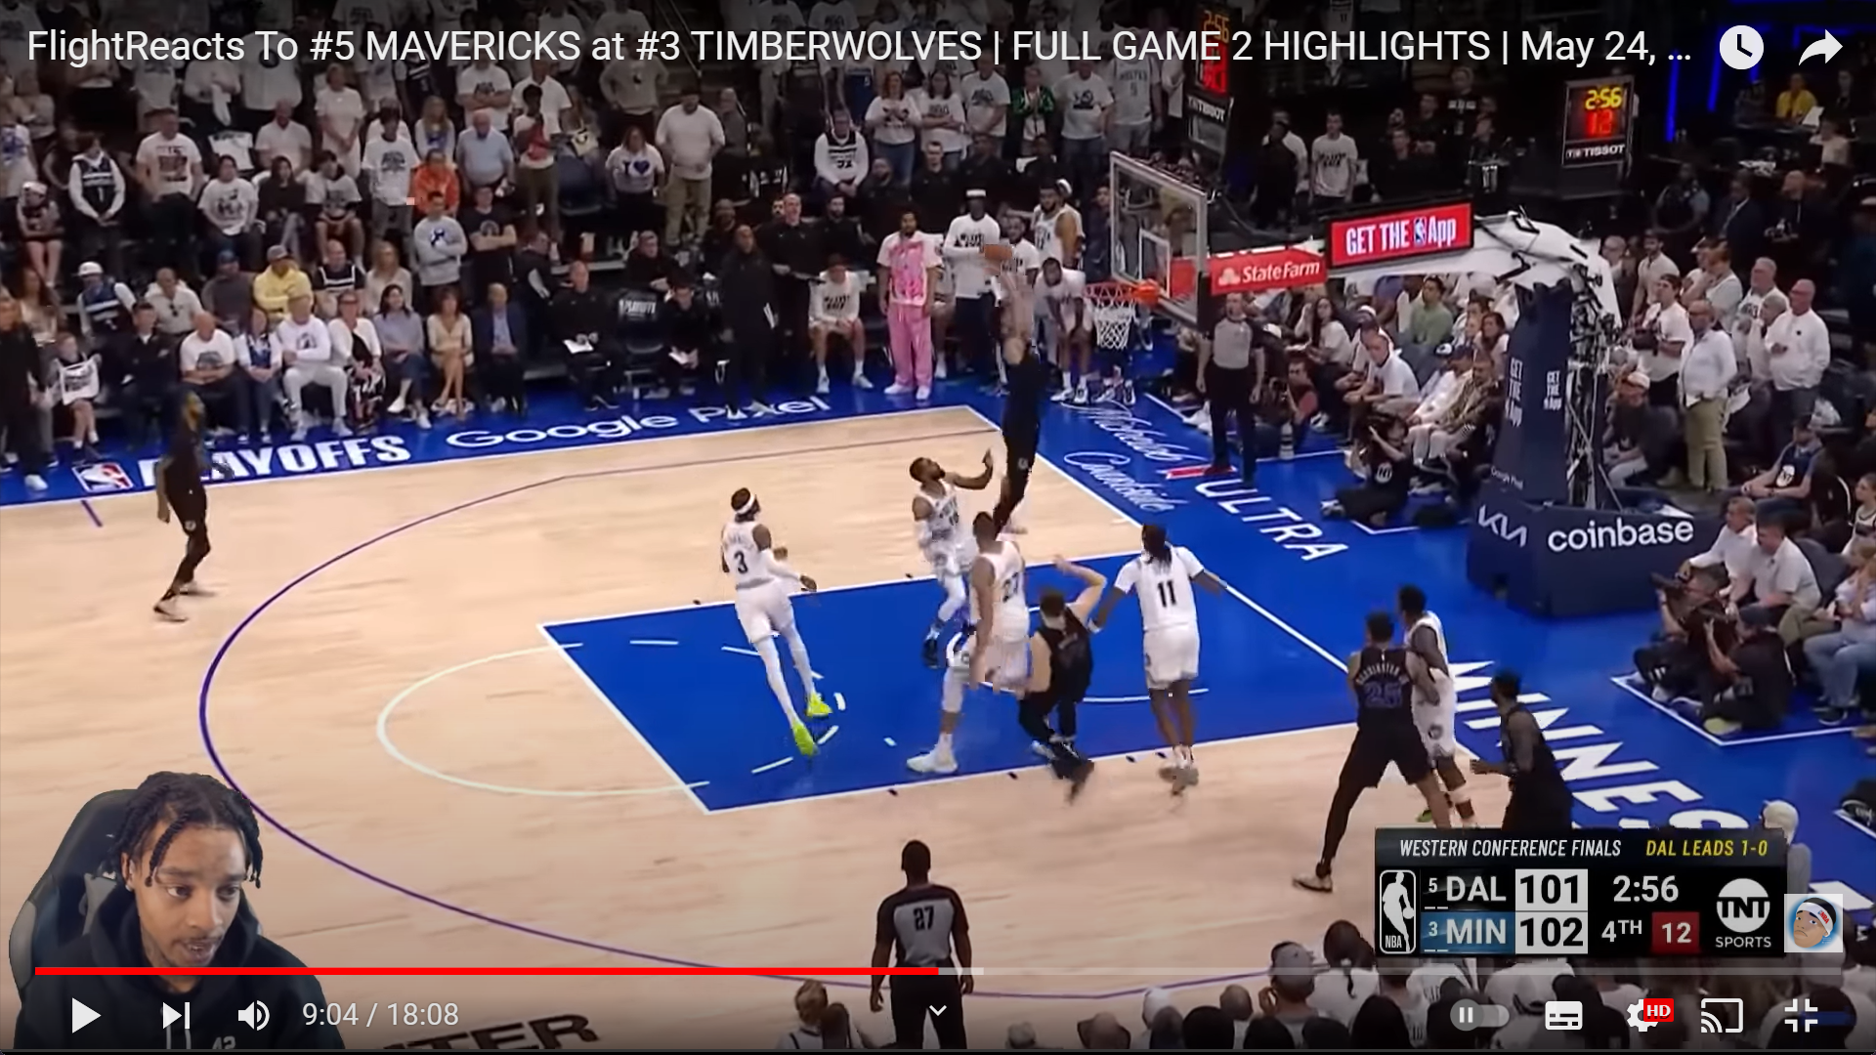
Creativity
Video Thumbnail and Picture:
Video:
There are not much creativity
Very Straightforward

Slide 7
Concept
Viewer can see the reaction of the streamer of seeing the NBA game video
Know his perspectives about the game
See other people who also love watching NBA game

Slide 8
Design
Front Camera
Window Display

Slide 9
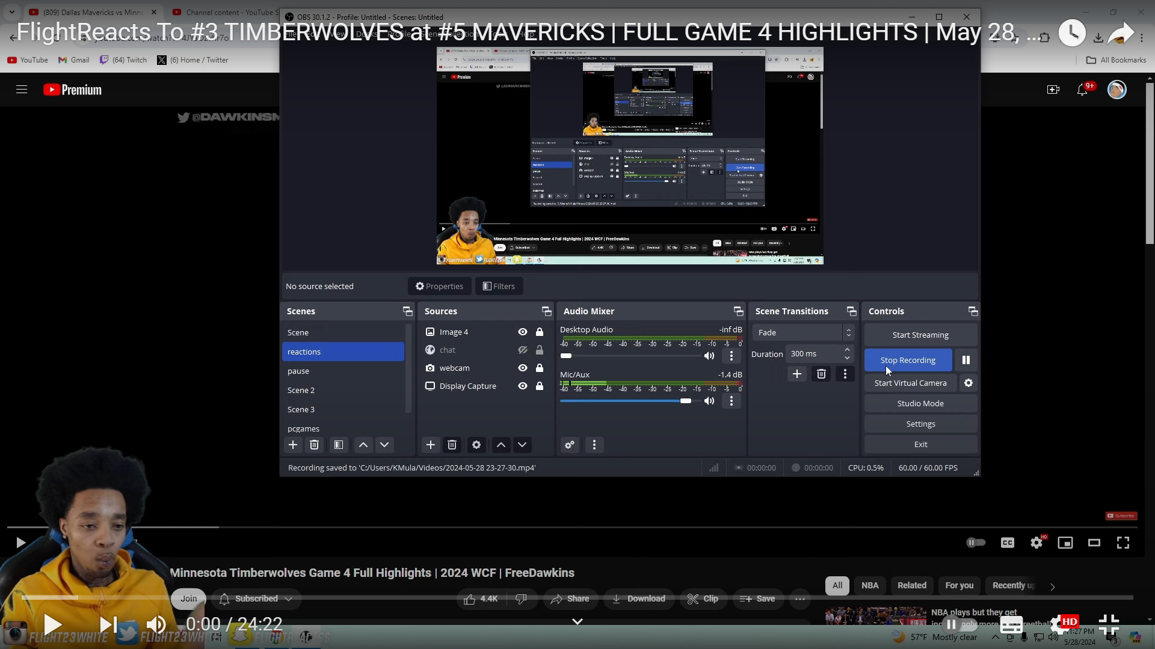
Media Technique
Streaming platform: OBS
Streaming Materials: webcam, microphone

Slide 10
Layout Design
A Screen Capture of the video

Slide 11

This is the end of the Analysis
of my favorite live streaming video
Thanks For Watching

